Slide 1
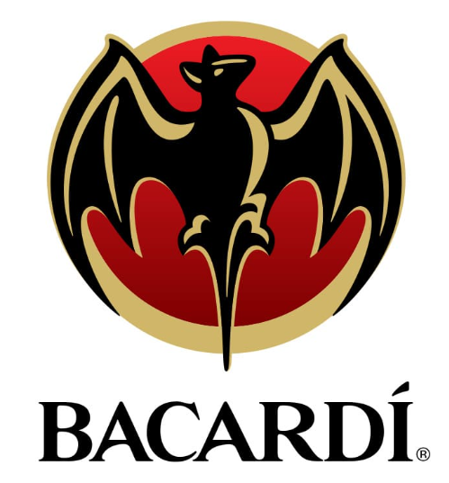
Bacardi Spirits
Bacardi

Slide 2
Agenda
Current State
Insights
Recommendations
Q&A
Notes:
Do: Review agenda

Slide 3
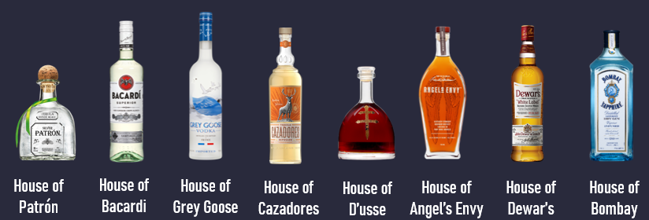
Current State
The client is the largest privately held spirits company
The major category of beverages analyzed by our group include bacardi, grey goose, cazadores and patron
The main questions that the client were how are they positioned for omni and how are they positioned in multicultural trends

Slide 4
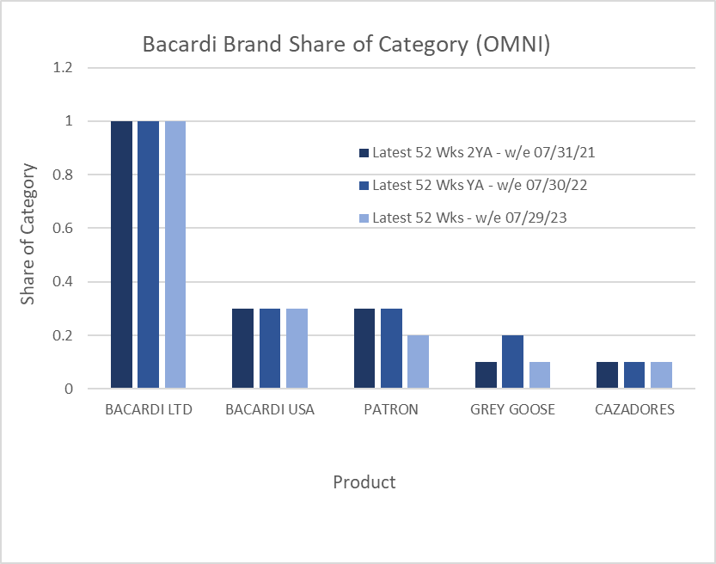
Most brands showed stability in their market share across different channels, with slight fluctuations
BACARDI LTD and PATRON showed an increase in their online market share, indicating possible growth in online presence or popularity.
BACARDI LTD consistently leads in market share across all channels and periods.
Cazadores was the only brand to show growth in the past 2 years
-2% | -3% | -6% | -2% | 11%
CAGR
Source: NIQ; Data Set; Market; Product; Fact; Period

Slide 5
Insights

Slide 6
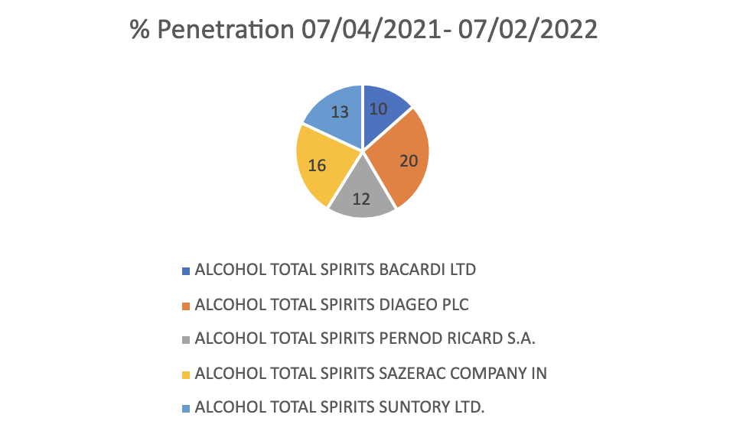
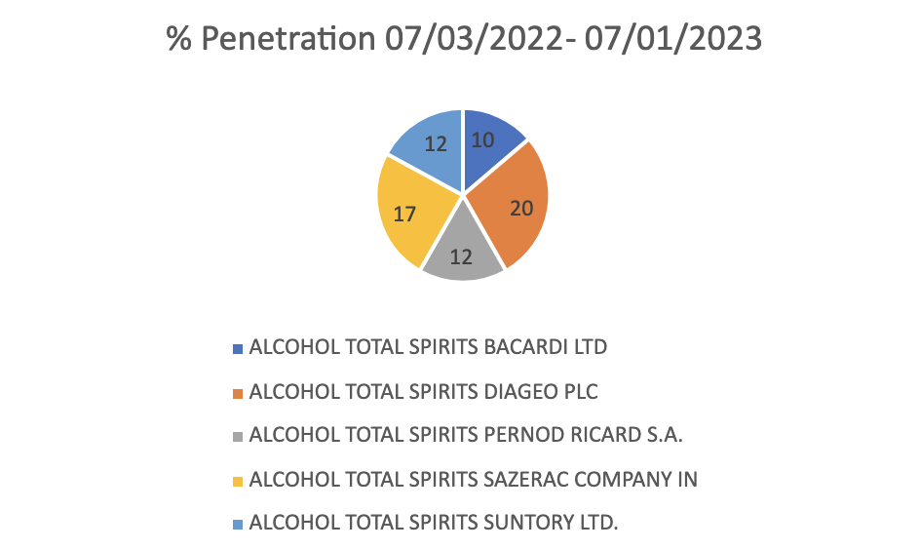
Changes in % Penetration in the Omni Space
Source: NIQ; Omni Behavior Trends; Total Available Retailers (Omni); Bacardi; % Penetration; 2 years w/e 7/1/23

Slide 7
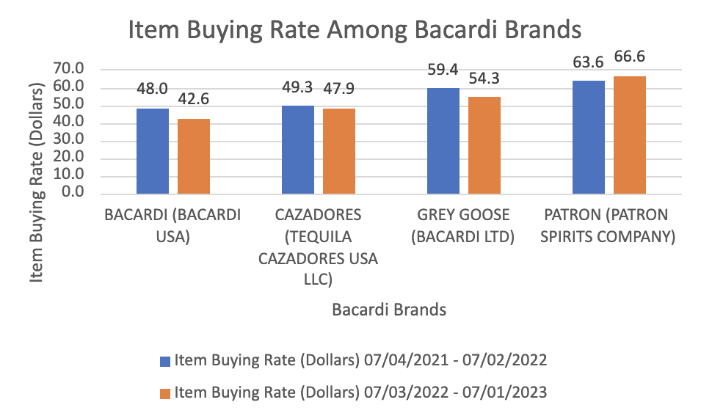
Changes in Item Buying Rate Among Bacardi Brands in the Omni Space
Source: NIQ; Omni Behavior Trends; Total Available Retailers (Omni); Bacardi; Item Buying Rate; 2 years w/e 7/1/23

Slide 8
Brand Demographics Facts
Grey Goose(Omni)
Hispanic Index
Black/African American Index
3% Increase
1% Increase
Grey Goose slightly over indexes with hispanics at 119 and the distribution of buyers has increased from 14%-17%
The Grey Goose brand over indexes with Black/African-Americans at 125 and the distribution of buyers has increased from 15%-16%.
Hispanics are 19% more likely to buy Grey Goose than all Grey Goose Buyers
Black/African-Americans are 25% more likely to buy Grey Goose than all Grey Goose Buyers
Source: NIQ; Omni Client Brand Demos; Omni; Grey Goose; Number of Buyers/Index; 07/02/2022-07/01/2023
Notes:
-With this 119 buyer index, this means that the Hispanic group of buyers are 19% more likely to
buy Grey Goose than all Grey Goose buyers
-With this in mind, we can confidently say that there has been a rise in Hispanic representation in the Grey Goose category as there has been a 3%
increase in the distribution of buyers in this demographic as we just mentioned

Slide 9
Brand Demographics facts
Patron (Omni)
Black/African American Index
Asian - Pacific Islander Index
Hispanic Index
13% Decrease
38% Decrease
11% Decrease
Source: NIQ; Omni Client Brand Demos; Online; Grey Goose; Index; 07/02/2022-07/01/2023
Notes:
Although each of these demographic groups still over index there is a steady decline that we should pay attention to

Slide 10
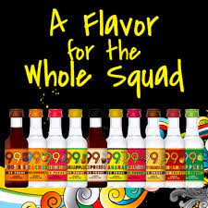
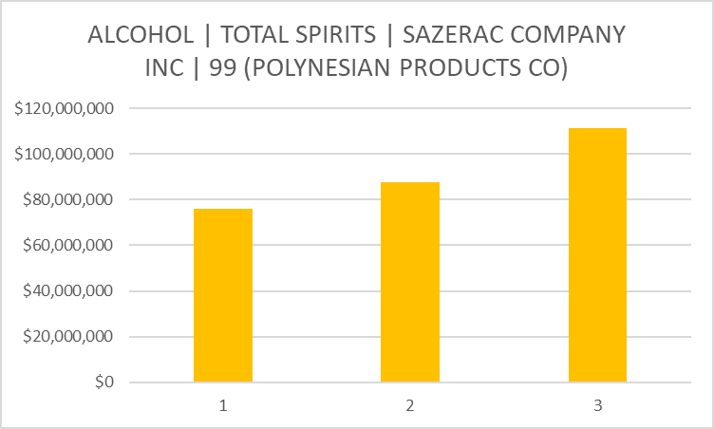
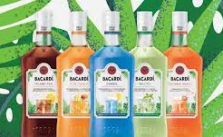
Flavored drinks are experiencing rapid growth and Bacardi’s product line provides exposure to this trend
Flavored alc. beverages from 99
2021
2022
2023
Flavored alc. beverages from Bacardi
Source: NIQ; Omni Sales Share trends; Period 2021-2023

Slide 11
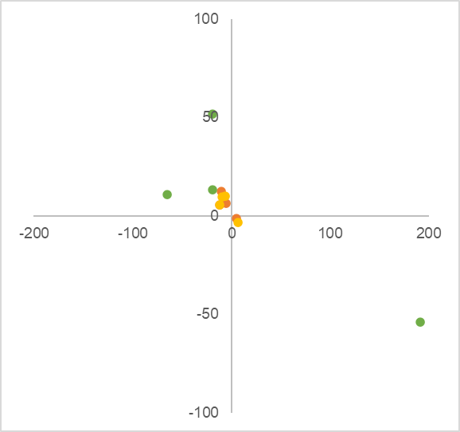
Correlation metrics for all Bacardi brands
Although there has been an increase in number of Buyers for Bacardi, this has come with a reduction in purchase frequency
There was an inverse relation between number of buyers and purchase frequency at Bacardi due to:
An increase in first time buyers who didn’t purchase again
More bulk purchases by customers who purchased less often
As an example, Grey goose experienced a surge in buyers, occasions and units purchased in the omni channel, but the frequency of purchase dropped
YoY change in number of buyers
YoY change in purchase frequency
Omni
In-store
Online
Source: NIQ; Data Set omni behaviour trends W5;bacardi overall,Period
Omni Client Brand Demos; Online; Cazadores,Patron; Index; 07/02/2022-07/01/2023
https://www.census.gov/library/stories/2023/09/2020-census-dhc-a-hispanic-population.html#:~:text=The%20Hispanic%20or%20Latino%20population,million%20since%20the%202010%20Census.
Sub header

Slide 12
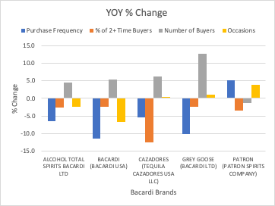
The Year-over-year % change for most Bacardi brands has been increasing in the number of buyers as well as occasions.
Buyer Trends
Despite this trend, Patron has not seen a steady increase in Number of Buyers and Bacardi has not seen an increase in occasions.
Bacardi Brands have also generally seen a decrease in purchase frequency and the % of 2+ time buyers
Source: NIQ; Data Set: Omni Behavior Trends W5: Purchase Frequency, % 2+ Time Buyers, Numbers of Buyers, Occasions

Slide 13
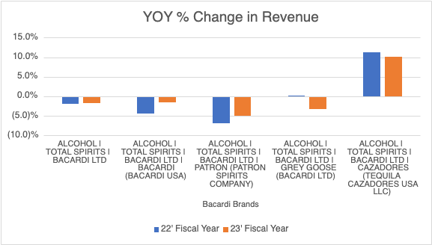
Buyer Trends
While there are a growing number of buyers on a growing number of occasions. All brands besides Cazadores have experienced a decrease in revenue year-over-year
With buyers purchasing less frequently and the % of 2+ time buyers decreasing, Bacardi brands may need to focus on increasing repeat business with customers
Source: NIQ; Data Set: Omi Sales_Share Trends W3: Products: $% Chg YA Latest 52 Weeks 07/30/22: $ % Chg YA Latest 52 Weeks 07/29/23

Slide 14
Recommendations

Slide 15
Recommendation
Supporting insights
 | Boost purchase frequency / occasions by Aligning promotions with cultural holidays Emphasizing utility in social gatherings Introducing heritage inspired limited editions
 | Opportunity to increase both purchase frequency and occasions for Bacardi products relative to peers
 | Increase awareness and adoption among multicultural demographic groups by Sponsoring multicultural events / festivals Partnering with multicultural artists, sports, brands Introducing variations with ethnic ingredients
 | Strong appeal for Bacardi brand across multiple demographics such as Hispanic / Asian (Patron, Cazadores) and African American (Grey Goose) Rapid growth of Hispanic and Asian demographic segments in the U.S.
 | Further promote Bacardi’s flavored beverage line especially among younger demographics Take inspiration from Sazerac 99’s marketing campaigns
 | Consumer trends have led to rapid growth in in flavored alcoholic beverages

Slide 16
Q&A

Slide 17
Thank you!
Bacardi

